Slide 1
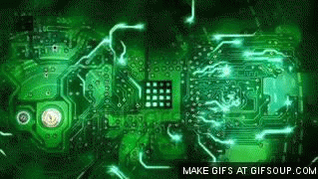
Electronic Technology
By Nathan, Ryan and Spencer

Slide 2
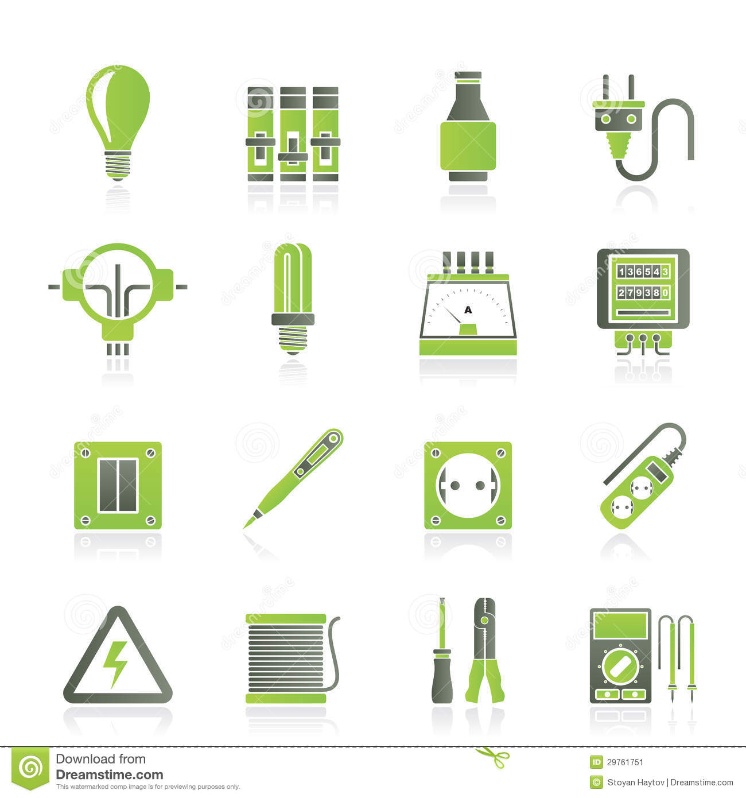
Electronic Vs. Electric
Electric means that the object is powered or run by electricity. There are electric devices that have integrated circuits in them but, not all electric devices have integrated circuits. The basis of all electric devices is that they are run, or powered by electricity.

Slide 3
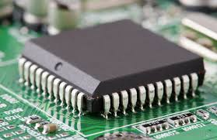
Electric Vs. Electronic
Electronic devices have Integrated Circuits in them to control how much power is let into the device and the direction they travel. They can also be called microchip.
Notes:
Hi I am your friend

Slide 4
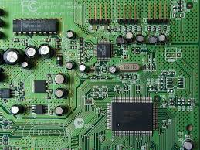
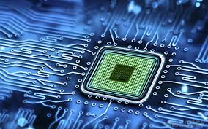
Integrated Circuits
An integrated circuit is a small chip of specially treated silicon containing many circuit parts. Integrated circuits carry out instructions, by controlling the electrical current.

Slide 5
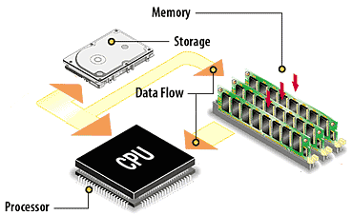
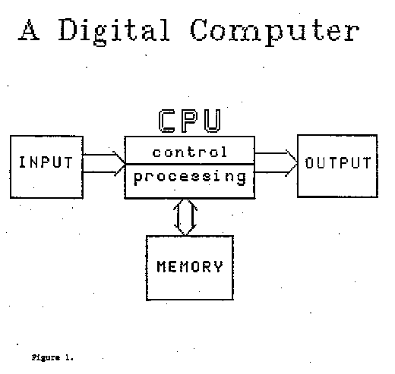
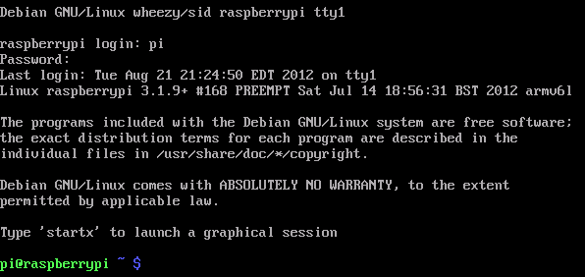
Basic computer functions
The four main computer functions are input, control processing, output, and memory. These basic functions are all computers do. They send digital signals.

Slide 6
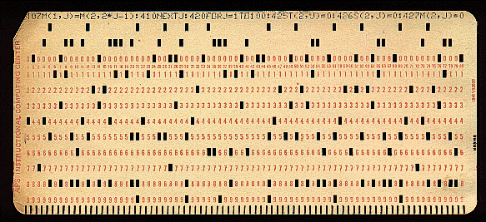
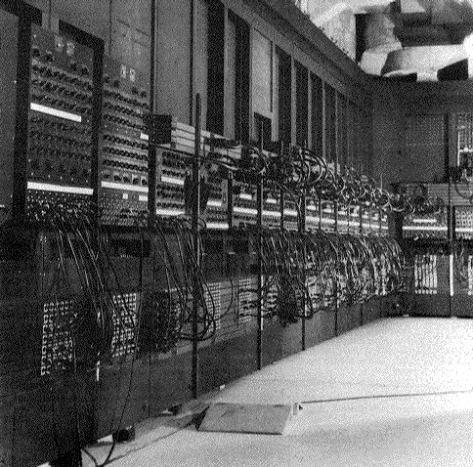
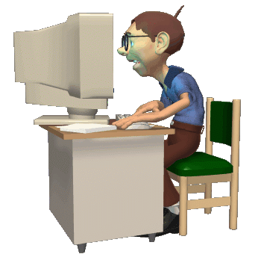
Timeline

Slide 7
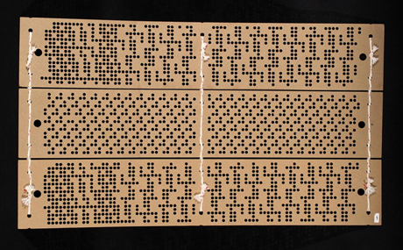
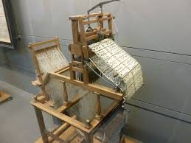
1800’s
In 1801, french weaver Joseph Marie Jacquard invented wooden punch card to program which pattern a loom would weave. The presence of a hole meant the loom needle could go through. and the absence of a hole meant it could not. Similar to the 1s and 0s of modern software.

Slide 8
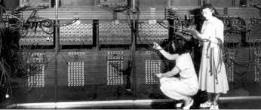
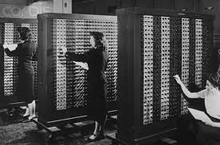
1900-50
In 1945, engineers completed one of the first general purpose computers,. the electronic numerical integrator and computer ENIAC. For the U.S. army, punchcard delivered information to be processed by almost 18000 vacuum tubes inside the 33 ton (66,000 pounds or 29937.096 kilograms) machines.

Slide 9
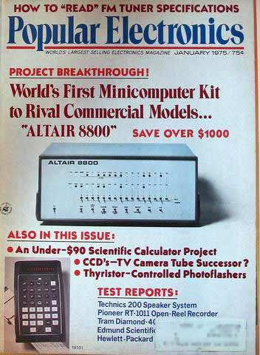
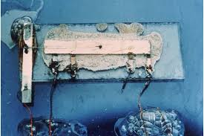
1950-75
In 1958, some developers introduced the integrated circuit, which allowed the development of smaller computers.
In 1965, the first commercially successful tabletop computer came on the market. It could sit on a table, but it was too expensive for home computing. In cost what the person might earn in 15 years!!

Slide 10
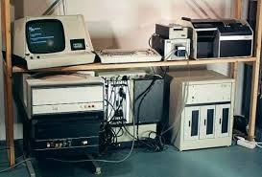
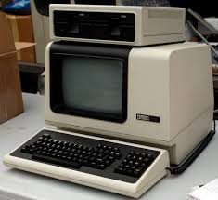
1975-2000
In the mid-1970s, personal computers like those used tokay first appeared. they had monitors, keyboards, and hard drives. These computers could store, process, and output information for people in their homes or business.

Slide 11
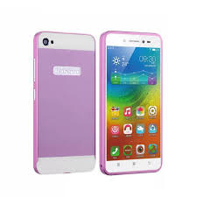
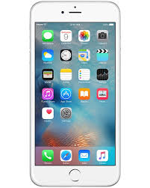
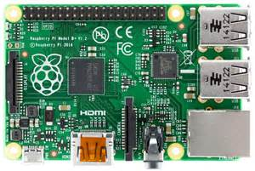
2000-2016
In the Twentieth century Touchscreen smartphones came onto the market. They allowed the user to make phone calls, send emails or surf the Internet almost anywhere. It combined the telephone and the computer.

